Slide 1

ScholarBot- Research ai agent
IBM HACKATHON PROJECT
AI-Powered Research Assistant Using IBM Cloud Lite & IBM Granite Foundation Model
Presented By : Akanksha Pandey
College Name : Kanpur Institute of Technology (KIT)
Department : Bachelor of Technology (BTECH)
Course : Information Technology

Slide 2
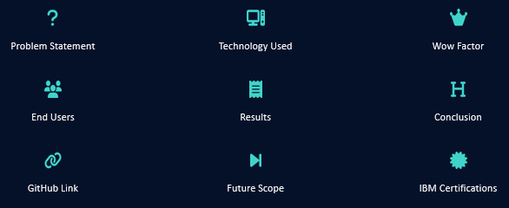
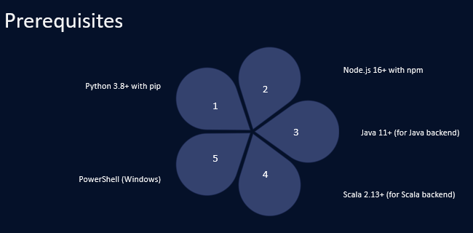
OUTLINE
Problem Statement
Technology used
Wow factor
End users
Result
Conclusion
Git-hub Link
Future scope
IBM Certifications

Slide 3
Problem Statement
❓ What’s the Challenge?
Researchers, students, and professionals often face difficulties like→
📚 Information overload when reviewing academic materials
⏳ Time-consuming manual research and literature review
🔍 Lack of centralized tools for querying across different AI services
🧠 No single intelligent assistant that understands context and evolves with user input

Slide 4
Proposed solution
💡 Our Solution
Academic – Watson Research Agent
An AI-powered research assistant that→
🤖 Uses IBM Granite & Watson ML for intelligent query understanding
🔄 Offers multiple backend options: Python, Node.js, Java, Scala
💬 Supports real-time chat + research modes
🎨 Has a sleek React-based UI
🔐 Provides seamless configuration and testing
🌐 Is platform-independent and mobile-friendly

Slide 5
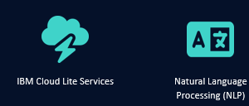
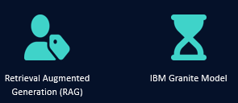
Technology used
IBM cloud lite services
Natural Language Processing (NLP)
Retrieval Augmented Generation (RAG)
IBM Granite model
Feature | Benefit
Watsonx + Granite | Real-time intelligent generation
NLP + RAG | Better understanding + factual precision
Multi-Backend Support | Flexibility across Python, Node, Java, Scala
React Frontend | Sleek, fast, mobile-friendly interface

Slide 6
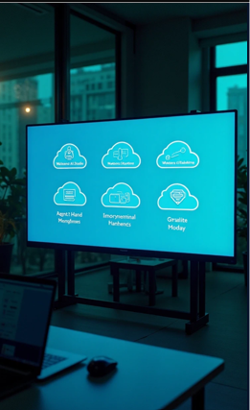
IBM cloud services used
ResearchAgent/
├── config.env # Environment variables (API keys, Watson config)
│
├── backend/ # All backend implementations
│ ├── python_server.py # Flask server (Python)
│ ├── node_server.js # Express server (Node.js)
│ ├── WatsonResearchAgent.java # Java backend
│ ├── WatsonResearchAgentScala.scala # Scala backend
│ ├── requirements.txt # Python dependencies
│ └── package.json # Node.js dependencies
│
├── frontend/ # React frontend
│ ├── public/
│ │ └── index.html
│ └── src/
│ ├── App.js # Main UI logic
│ ├── index.js # Entry point
│ ├── index.css # Tailwind CSS + styling
│ └── components/ # Future component separation
│
├── scripts/ # Dev tools and setup scripts
IBM Cloud Watsonx AI Studio
IBM Cloud Watsonx AI runtime
IBM Cloud Agent Lab
IBM Granite foundation model

Slide 7
factors
🔁 Multi-Backend Architecture
🐍 Python | 🟢 Node.js | ☕ Java | 🟡 Scala — One frontend, many brains
Unique approach that supports multiple backend engines
Flexibility for enterprise-level integration and scalability
💬 Dual Interaction Modes
Simple Q&A for quick queries + Chat Mode for conversations
Smart chat retains history and context
Gives a realistic research assistant feel
🌐 React Frontend + Real-time API Switching Choose your backend in real time, test connection instantly
Live connection
Checkfully responsive UI (desktop + mobile)
Clean UX with modern design system (Tailwind / Vite)
🧠 Powered by IBM Granite + RAG
Combine generation + retrieval = smarter answers
Uses Granite Foundation Model for advanced reasoning
Integrated Retrieval-Augmented Generation (RAG) with PDF/document knowledge
Provides context-aware, research-grade answers
⚙️ Zero Vendor Lock-in
Can run on IBM Cloud Lite, or locally — fully open & extensible
IBM Cloud APIs, but dev-friendly for local testing
Configurable through .env and CLI
🚀 Bonus WOW:
Fully documented PowerShell scripts to spin up each backend
End-to-end RESTful APIs with health checks and custom routing
Designed with developer experience (DX) in mind

Slide 8
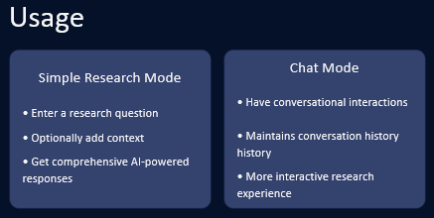
End users
🎓 Students→
Summarize academic papers, generate assignments, get quick topic overviews
Perfect for research projects, thesis writing, and exam prep
🧑‍🏫 Researchers & Professors→
Automate literature reviews
Draft abstracts, related work, and research summaries
Validate and cross-reference research findings
🧑‍🔬 Data Scientists & AI Engineers→
Use as a knowledge base for AI papers, algorithms, and trends
Explore cross-domain use cases using RAG
📚 Academic Institutions & Libraries→
Provide AI research assistant kiosks or portals
Help students with queries on-demand
Can be deployed across multiple departments
🧠 Content Writers & EdTech Startups→
Generate education-oriented content faster
Integrate backend as an API for learning platforms

Slide 9
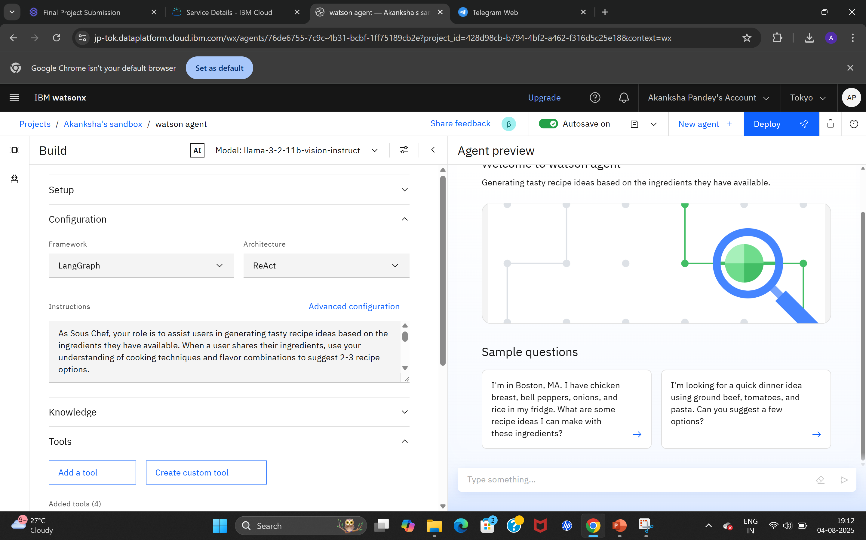
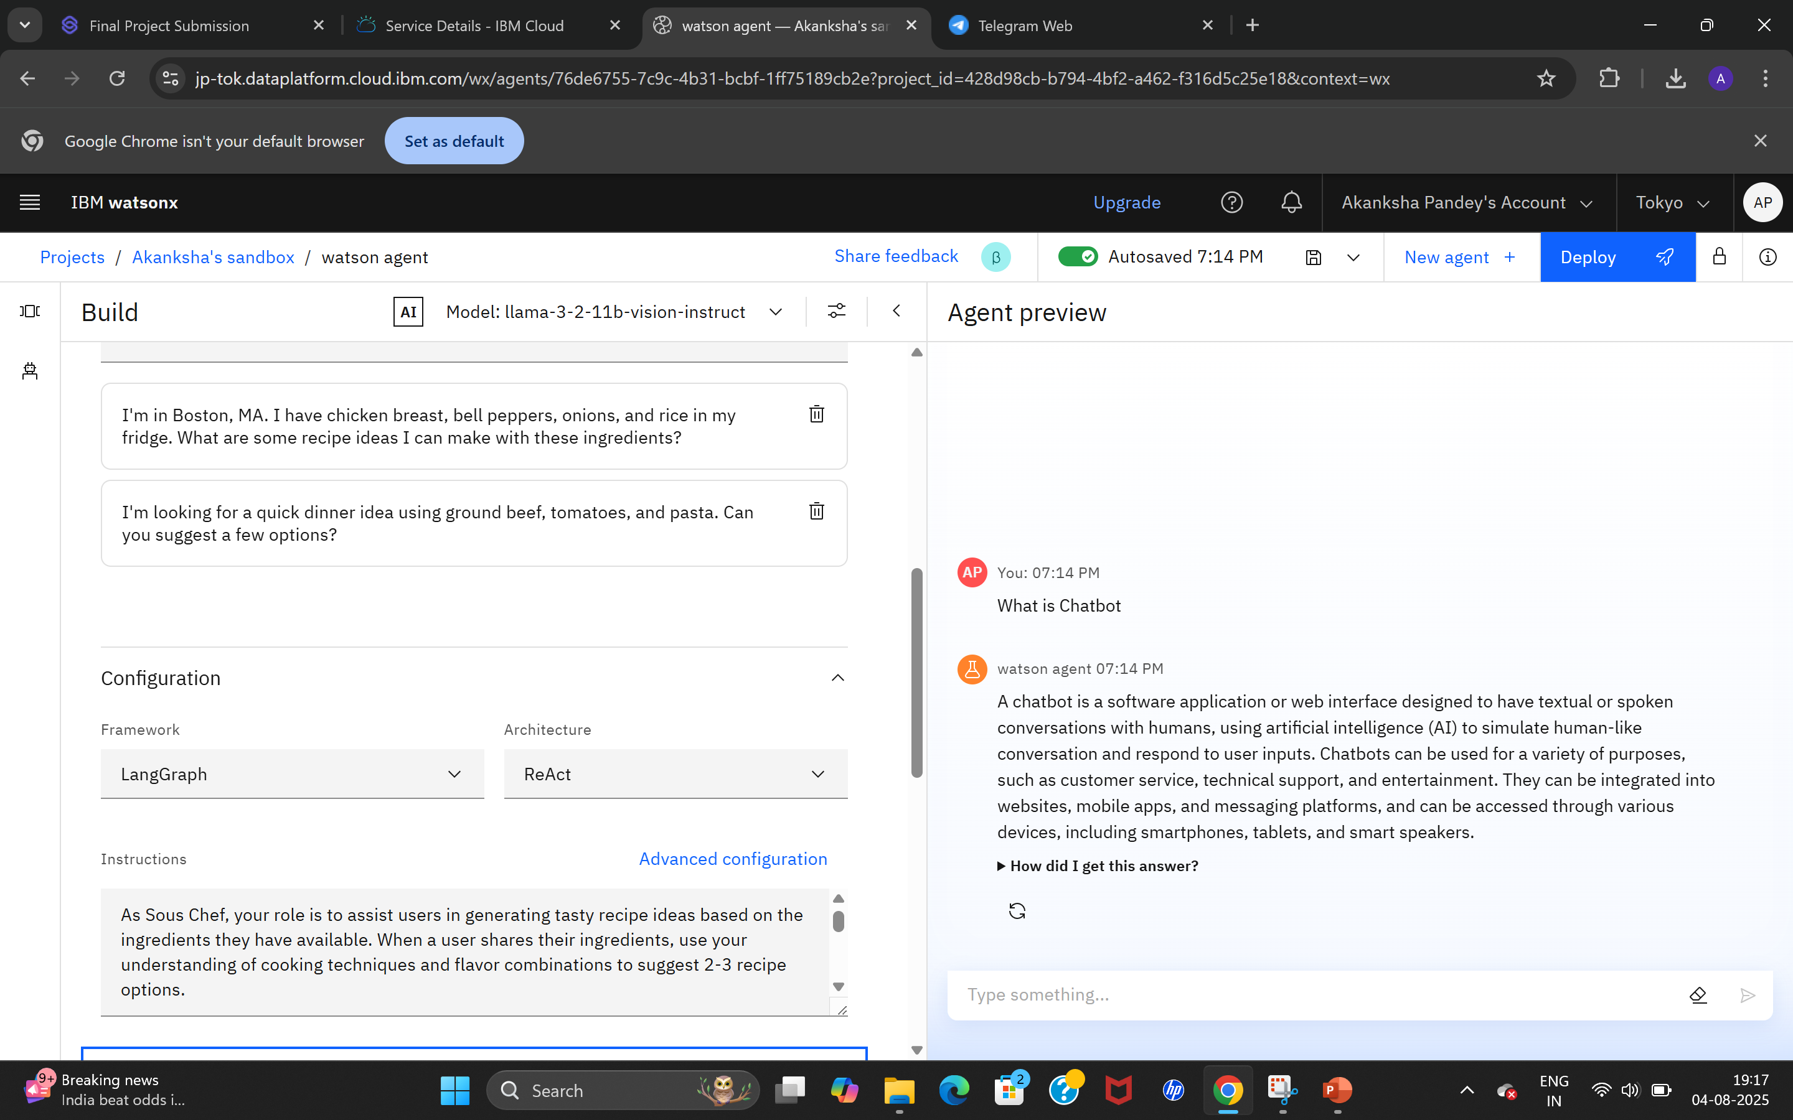
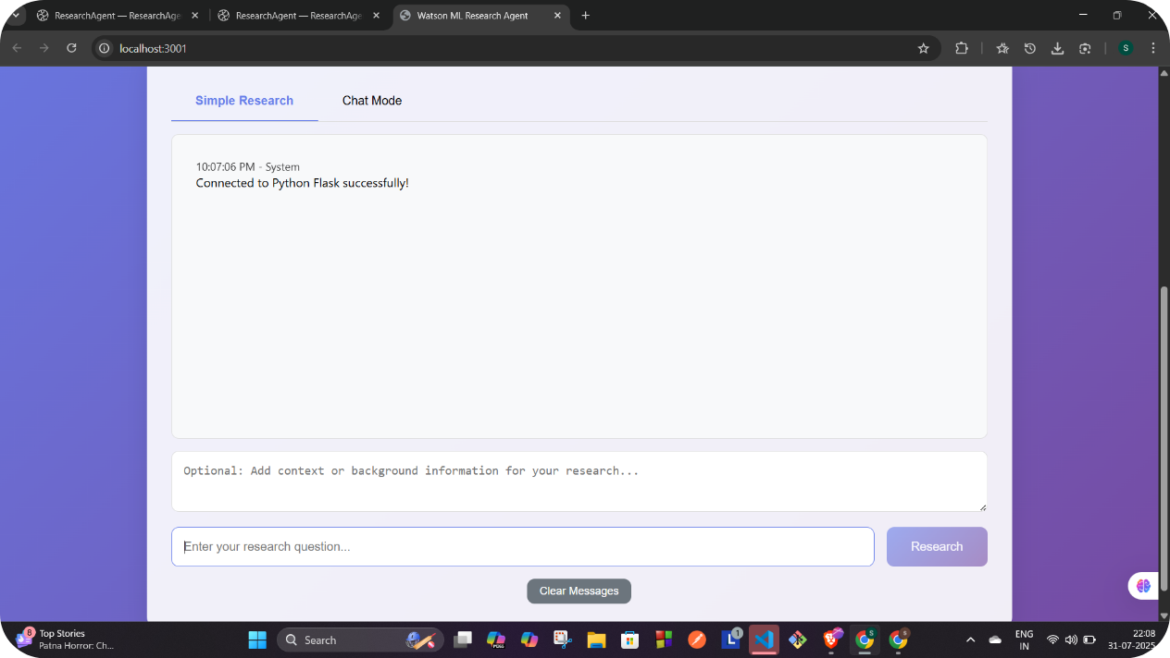
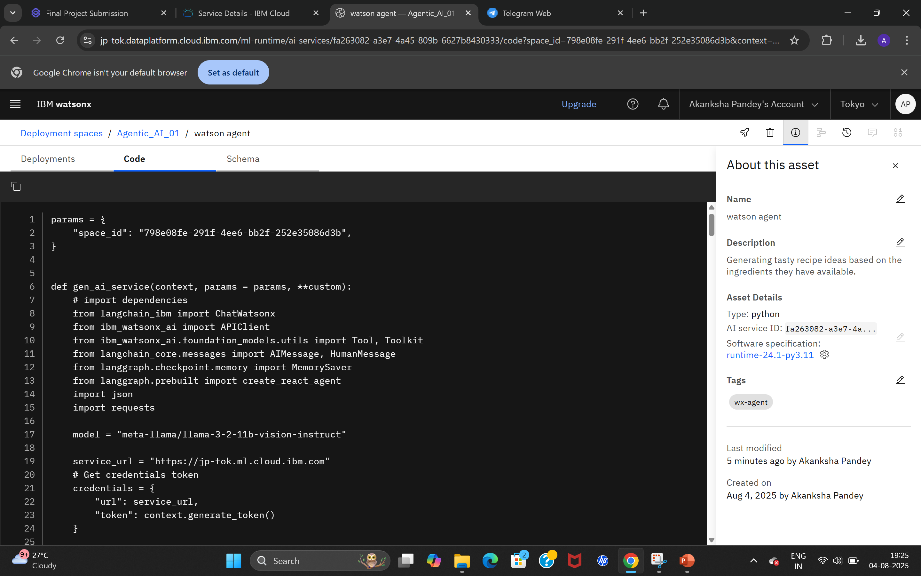
Results

Slide 10
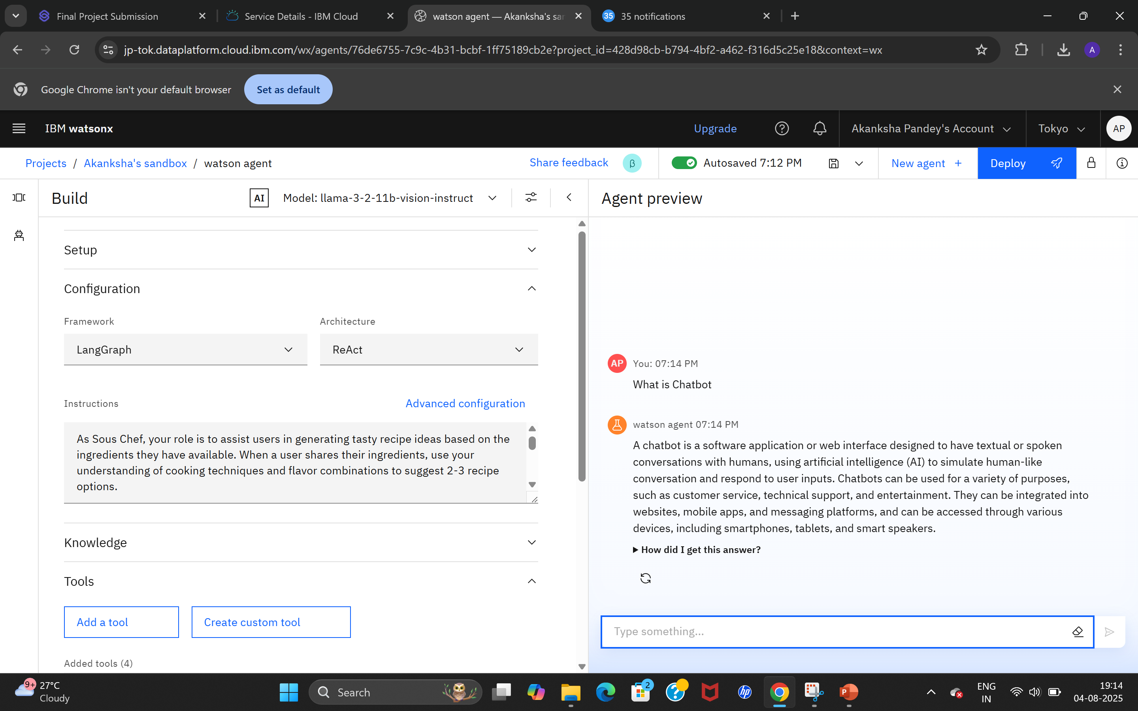
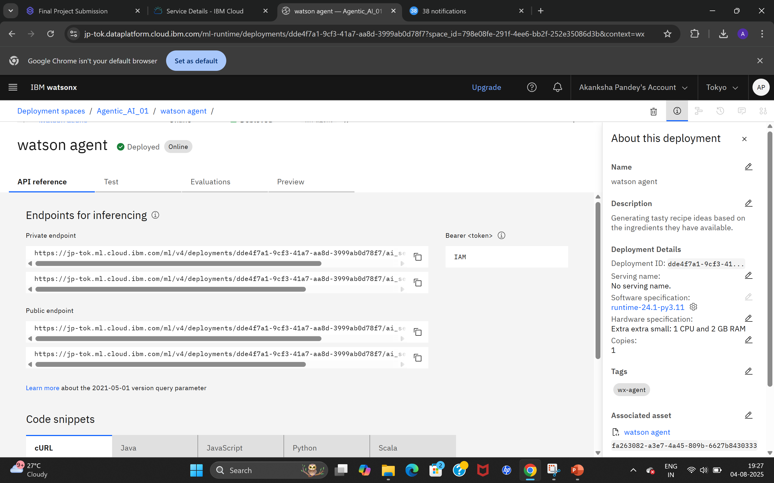
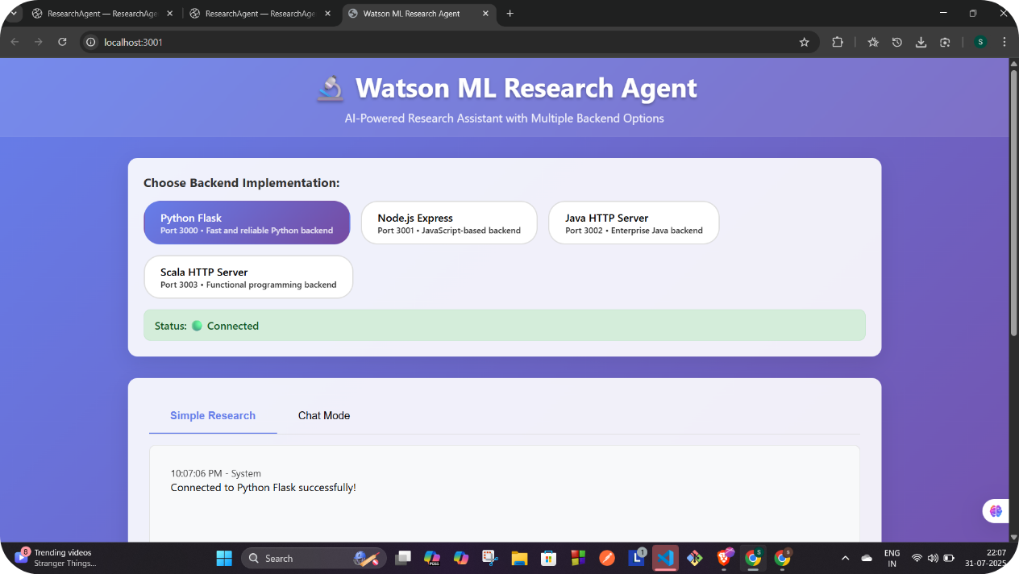
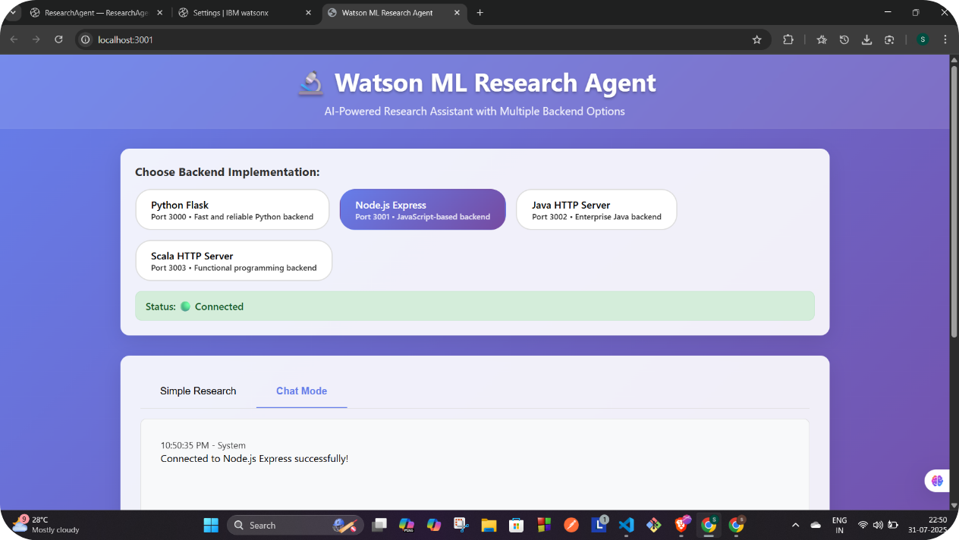
Results

Slide 11
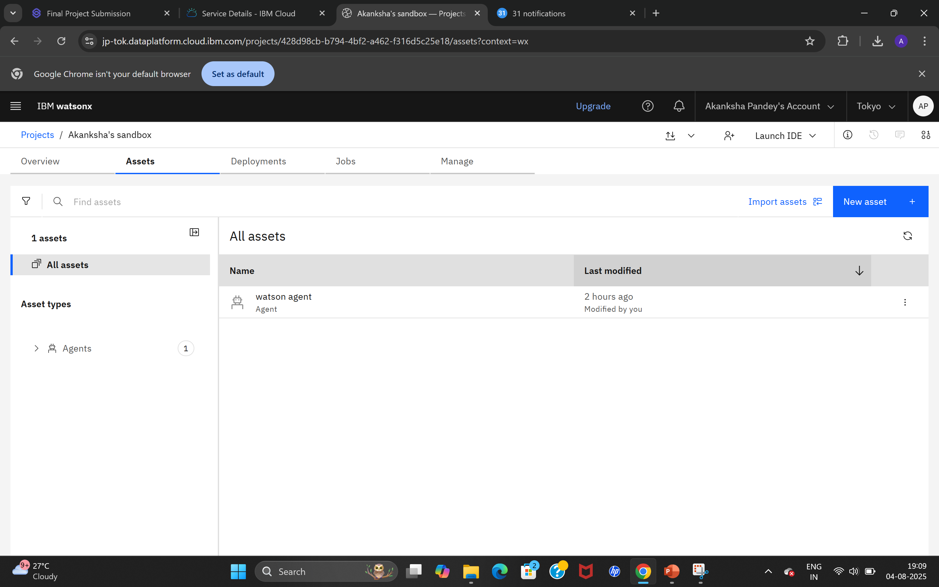
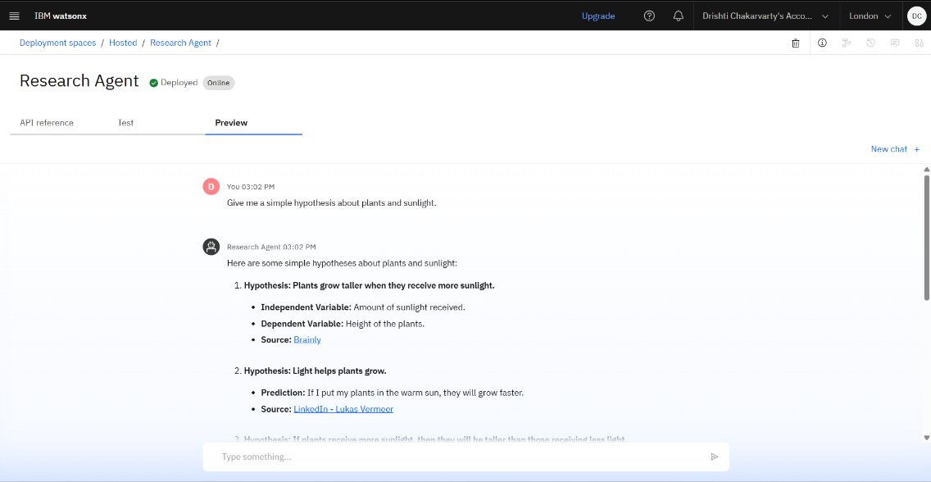
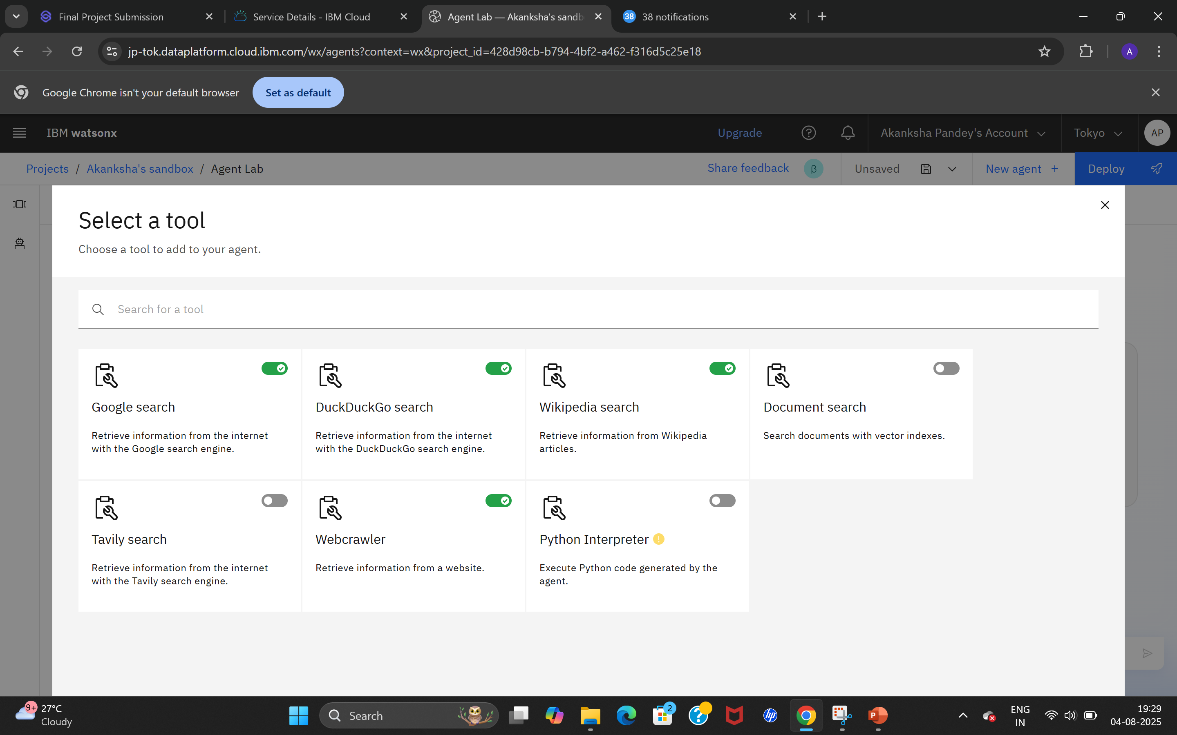
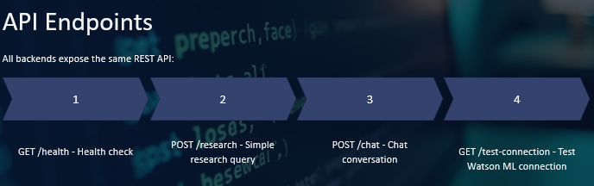
Results
Deployed AI Agent

Slide 12
Conclusion
🎯 What We Achieved?
Built an intelligent AI-powered research assistant using IBM Watsonx.ai
Leveraged Granite foundation model with RAG and NLP to simulate a real academic assistant
Developed a multi-backend architecture (Python, Node.js, Java, Scala) with a sleek React frontend
Enabled dual interaction modes: Simple Research and Chat Mode
Successfully deployed and tested using IBM Cloud Lite services
🚀 Why It Matters?
Saves time, boosts productivity, and enhances the research workflow
Scalable for real-world academic use cases
Flexible architecture for developers and institutions alike
💬 Final Thoughts→
"We didn't just build a chatbot — we built a future-ready, open-source Research Intelligence Platform powered by IBM's AI ecosystem."

Slide 13
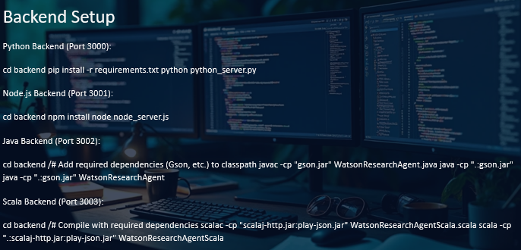
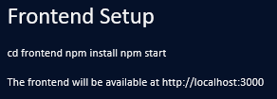
GitHub Link
🔗 GitHub Repository
🚀 Explore the full source code, backend logic, frontend UI, setup scripts, and IBM Cloud integration
here:👉 ResearchAgent
💡 Star it. Fork it. Use it.
This project is open-source and built to help students, researchers, and developers build AI-powered tools with IBM Watsonx and Granite.
Let’s reimagine academic research—powered by AI. 🌐🤖📚

Slide 14
Future scope
🧠 Voice-Based Research Assistant→
Integrate speech-to-text and text-to-speech for a hands-free academic assistant.
Helpful for visually impaired users and multitaskers.
Enables smart assistants on mobile & voice platforms.
📚 PDF Upload + Summarization→
Let users upload full research papers and receive --
Key takeaways.
Summaries per section.
Highlight extraction with RAG.
🌐 Multilingual Support→
Expand usability across regional and global languages using --
IBM Watson Language Translator.
Granite’s multilingual understanding.
💾 User Profiles + History→
Enable login, personalization, and saved research threads.
Track progress, bookmarks, and export data.
Provide tailored suggestions based on history.
🤝 Integration with Learning Platforms→
Turn the agent into a plugin or API for --
University portals, LMS systems (like Moodle, Google Classroom),EdTech apps.

Slide 15
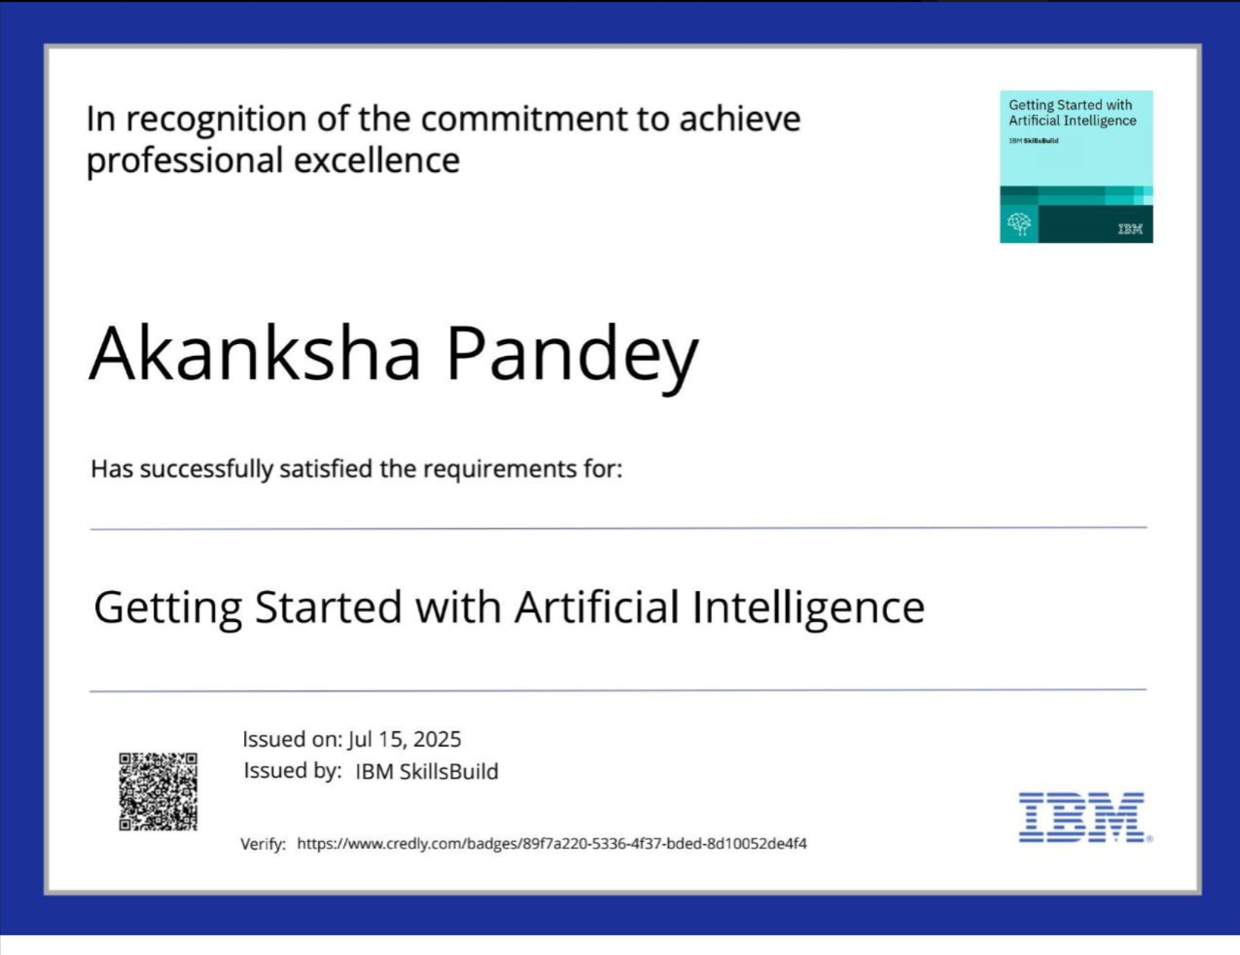

IBM Certifications
Screenshot/ Credly certificate
(Getting started with AI)

Slide 16
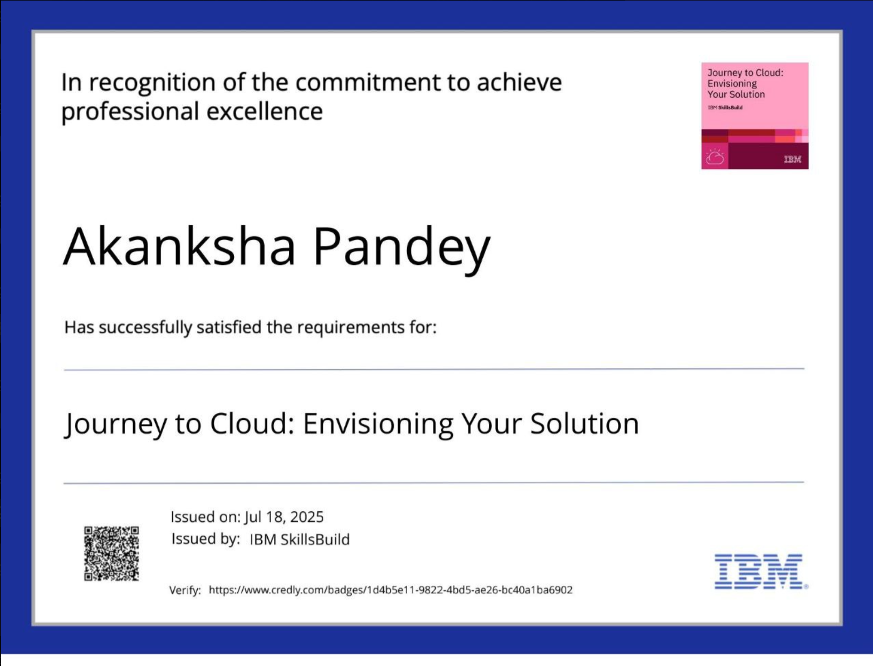
IBM Certifications
Screenshot/ Credly certificate
(Journey to Cloud: Envisioning Your Solution)

Slide 17
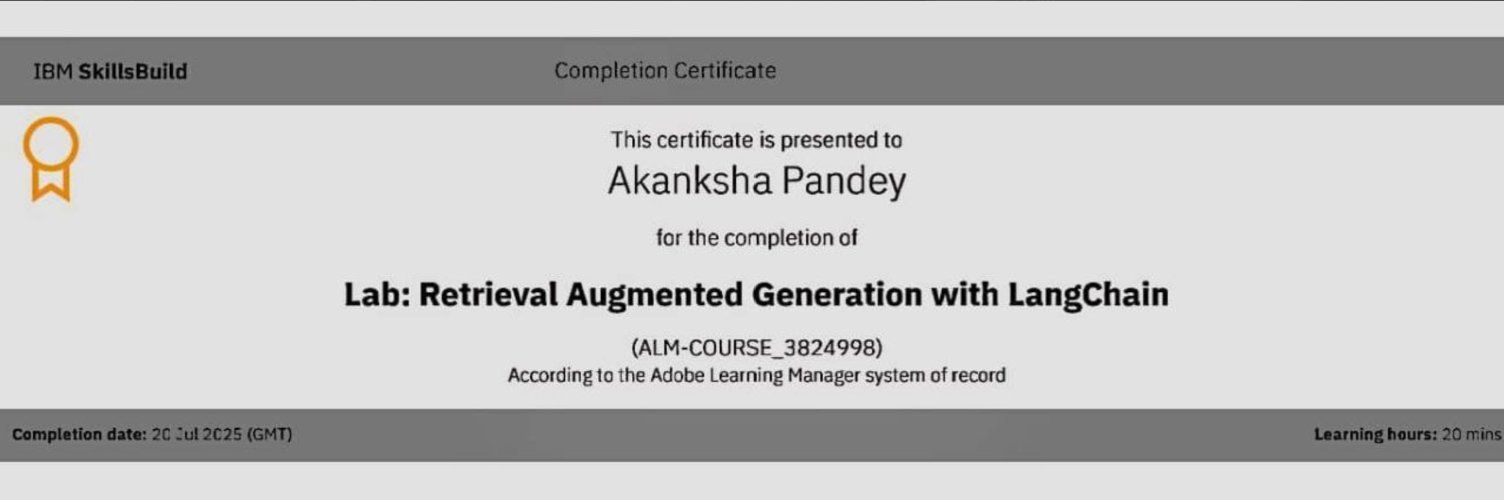
IBM Certifications
Screenshot of certificate
(Lab: Retrieval Augmented Generation with LangChain)

Slide 18
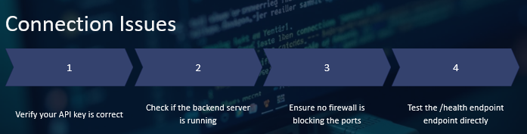
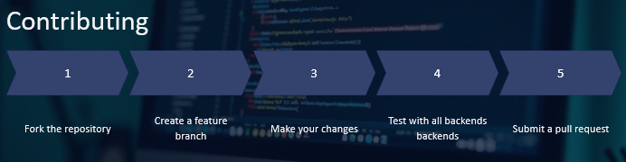

THANK YOU!!

